Slide 1

FRC Scouting Recommender
J. Patrick Bernard
MSDS692 Data Science Practicum 1
Notes:
Thank you for joining me today.

Slide 2
Agenda
Purpose
Assumptions
Data Engineering
Process
Results
Next Steps
Lessons Learn
Questions
Notes:
Here is the agenda for this presentation. We will be covering the purpose of the project. Assumption that I made. The data engineering and cleaning that needed to be performed. How I developed the recommender, The results of the analysis and verification. I will cover the next steps for this project and some lessons learned.

Slide 3
Purpose
The purpose of my project is to build a recommender that a FIRST FRC Robotics team could use to select the best possible alliance partners for the final rounds.
The recommender will group teams with compatible scores that will yield an optimal opportunity of winning matches.
Notes:
The purpose of this project is to build a objective recommender that will assist a First Robotics Completion team in selecting alliance partners for the final rounds. The output of the recommender will be a list of possible pairings a team could employ.

Slide 4
Hypothesis
My hypothesis is that by analyzing historical match scores a recommender can be developed.
Match data can be divided into two parts.
Qualifying round data
Used to develop the recommender
Final round data.
Used to verify the recommender
Notes:
I believe that if we analyze past match scores an objective recommender can be developed. There are two parts to the data. The first part is the qualifying rounds, this is the data that will be used to develop the recommender and is the data available to the team for making decisions with during a regional competition. The final rounds data can be used to somewhat verify the recommender.

Slide 5
Background
Matches
Played by 2 alliances (Red and Blue) of three teams each
For qualifying rounds the alliance are randomly paired
Why is this tool important
For final rounds the top eight team get to choose their alliance partner
This tool provides an objective view of team performance for alliance selection
Notes:
Matches are played by two alliances of three teams each. Alliances score points and winners are determined by the alliance that has the most point. Qualifying round alliances are randomly formed. Teams will play several match to determine a ranking for the teams. After completion of qualify the top eight teams get to choose their alliance partners. This is when the tool comes in. The tool will provide objective information the team can use choosing its alliance partners.

Slide 6
Assumptions
Because scores are reported for an alliance and not individual teams, I assign the alliance score to each team, I am assuming that better teams will aggregate higher scores over the course of qualifying rounds.
Using a large number of matches will provide enough information to derive the probability of win
I also assume that there will be other criteria collected at the regional competition in addition to make the final alliance selection.
Notes:
I assume that better team will aggregate higher scores over the course of qualify rounds even though the scores are generated by alliances. Using a large number of matches for model development a more accurate probability of win will be calculated. I assume that there will be additional criteria used in the final selection of an alliance partner.

Slide 7
Data Engineering
Data Source:
The Blue Alliance https://www.thebluealliance.com/.
This site collects information on FRC teams and matches around the world.
Match data is reported in alliance of the three teams verses another three team alliance.
For my analysis I will have to transpose the data so that each team is assigned a match score.
Notes:
My data was downloaded from the website “the Blue Alliance. Com” This site collects information on all the FRC competitions world wide. The information is stores and disseminated via their app and other methods for teams and spectators to consume. Data is reported by match and alliance. For my project I will have to transform that data to a team focus.

Slide 8
Data Engineering (2)
Data used for years 2016 through 2019
Data files retrieved
Events (72495 rows)
Tuned into ~434,000 rows
Awards (16380 row)
Notes:
I used data from the years 2016 through 2019. For event/match I down loaded ~72,000 rows that was turned in to ~434,000 row after transformation. The award files contained ~16,000 rows of data.

Slide 9
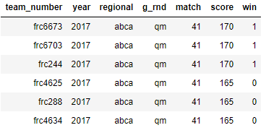
Data Cleaning
Data from Blue Alliance
Event data is organized by regional and match
Data needs to be transformed so that match scores are applied to each team and a win flag is set
one row for each team
Separate year, region, match, round into separate columns
Verify column parsing:
'Final', 'QtrF', 'Qual', 'SemiF’
Match identifiers are integer values
Data transformed for modeling and processing
Notes:
For the event data, the data was formatted as you can see in the “from Blue Alliance figure”. What I needed the data to look like is in the figure below. So for each row that was read in, 6 rows of data needed to be created and a win flag needed to be set to identify who won each match. I also had to parse the year,regional,match column into separate year, regionals, round, and match columns. For clarity I gave each round a more descriptive identifier.

Slide 10
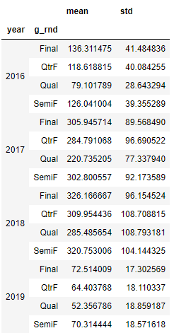
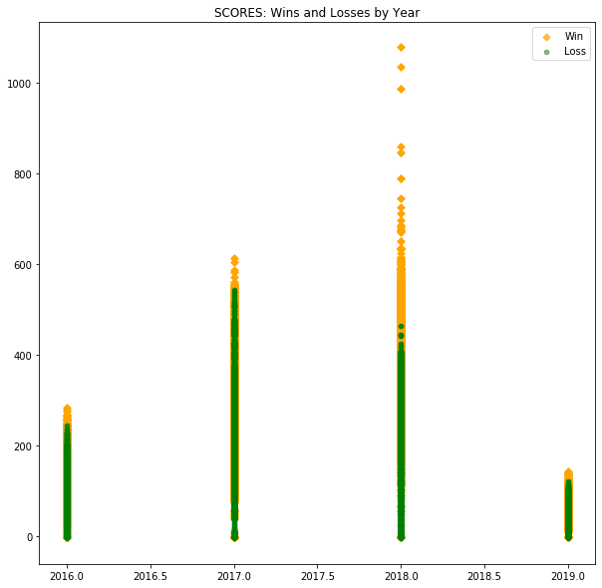
Data Exploration
Game Score Statistics
Number of active teams world wide : 3758
Notes:
For a first look at the data I plotted the scores from each year color coding them by win, yellow, or lose, green. This plot shows the effect of a new game being played each year. The method of scoring changes each year and the range of possible values is different. To be able to compare the data the scores will need to be standardized. I also looked at the mean and the Standard deviation of the scores. I calculated these for each year and I separated them into the round that was being played. This is important to understand since as the matches go from qualifying to finals the mean score increases for each round. This helps set expectations as teams go into the final round and will be selecting partner teams.

Slide 11
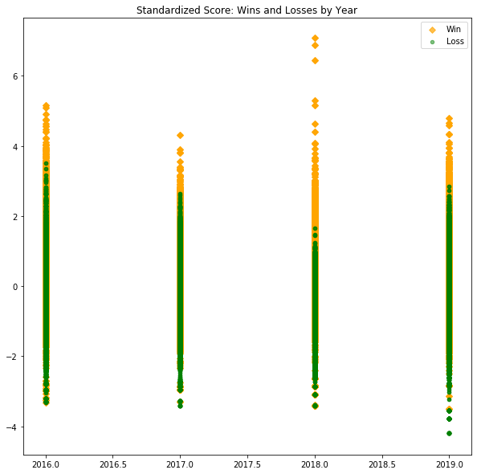
Data Exploration (2)
Scores have been standardized
By year
By round
Standardization is Zero mean Unit variant
Make scores from different years comparable
Notes:
Now that each year and rounds have been standardize to a zero mean value and unit standard deviation. The data for each year is now comparable and we can treat it and one data set.

Slide 12
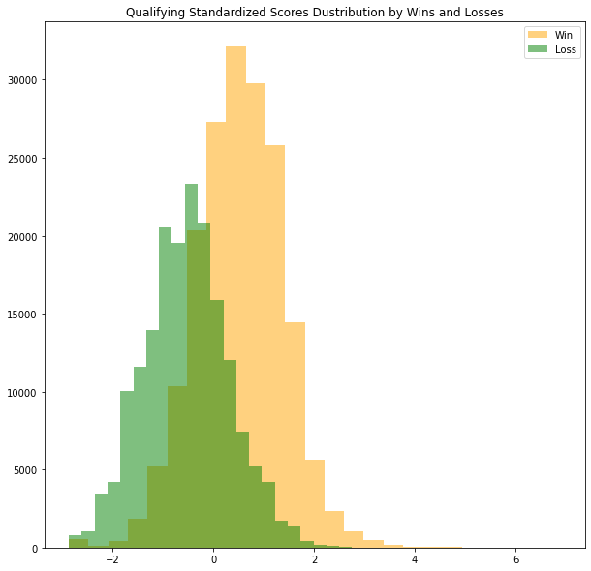
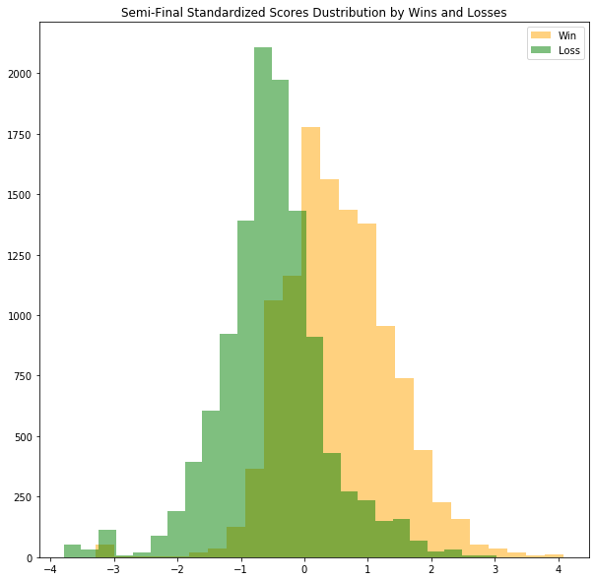
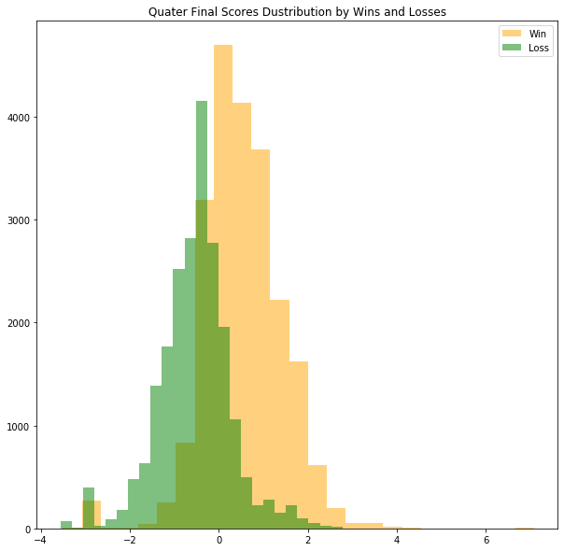
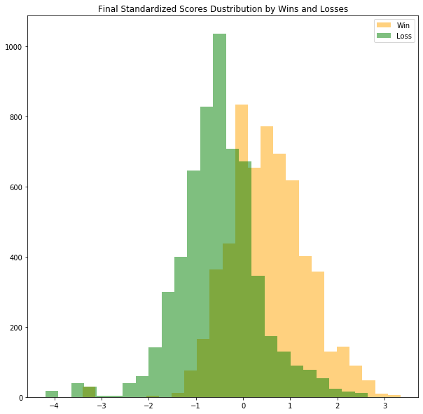
Data Exploration (3) Distributions
Standardized scores Grouped by win/Loss
Qualifying round
Semifinals
Wins
Losses
Quarter Finals
Finals
Notes:
Here is the data distribution by round for all of the standardized data. I have outline the mean value with a red box for easier identification. For all of the charts the data has a normal distribution. Because of this, we can use analysis techniques that assume a normal (gaussian) distribution and not have to account for it. I also noticed is the darker green region. This is the overlap of the wins and lose data. This is an indication of scores that could either win or loose the match. As the scores move from qualify through the final rounds you notice there is a change in shape. The overlap in qualifying is broad and tall indicating there are more possible ambiguous scores. In the final round the overlap is narrower and it is also skewed to the right. Even though the scores are higher it still does not guarantee a win.

Slide 13
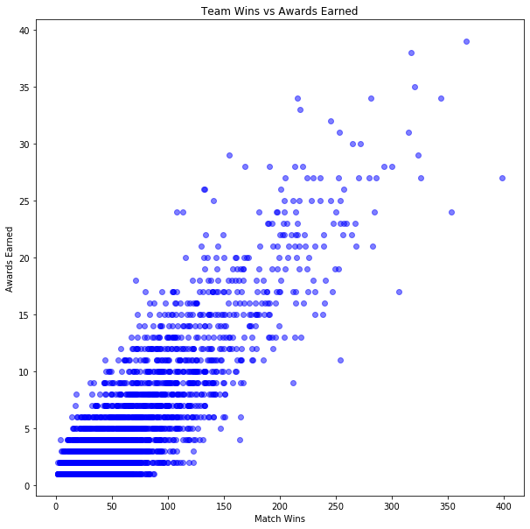
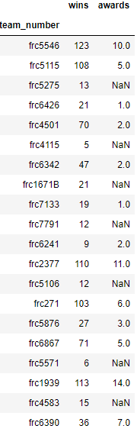
Are Award Important?
Random sample of teams match wins and number of awards won
Could this be a feature in the selection of a team?
Notes:
A common discussion within teams: Are the award important? When looking at the figure on the left I have graphed the number of matches won verses the number of awards won. You can see that teams that have won more matches are also teams that have won more awards. Remember this is only for the four year period of data being analyzed. This may not be a feature for selecting a team to join you alliance. I do think it is an indicator of teams that have well established processes and are consistent performers. I did include a table that has a random sample of records to further demonstrate the results.

Slide 14
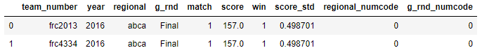
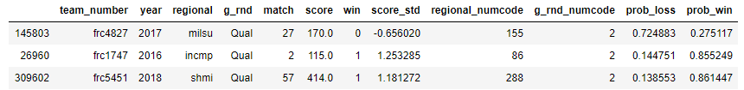
Data Prep and Model Creation
Turn regional & rounds to categorical integer data
Use a logistical regression to determine the probability of win and Loss
Features used
'year','score_std','regional_numcode','g_rnd_numcode’
Notes:
There is one more step of preparation needed. The categorical data, regional names and the rounds columns needed to be turned into numeric values for processing. For the development of the model I used year, standardized score, regional_numcode ,g_rnd_numcode as feature of the model. A logistical regression was used to determine the probability of win and probability of loss. This also set the weights and bias of the model so that new data can be run through the model and calculate the probability of win and lose can be calculated for that data too. The new data does not change the weights and biases of the model.

Slide 15
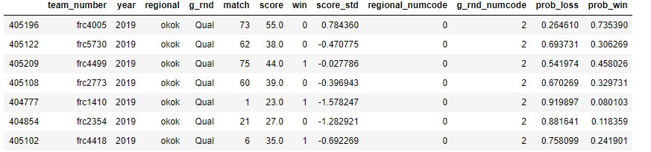
Recommender Creation
Extracted data for a single regional competition
Chose 2019 Oklahoma City
Extracted the data as it is expected to be delivered on the Blue Alliance site
Preprocess data to by team format
Run the model to get Probability of Win and loss for each qualification match of the regional event
Notes:
To create the logic for the recommender I extracted the data for the 2019 Oklahoma City regional. I extracted only the qualifying rounds to emulate the data the team would have available for decision making. My first step was to configured the data into the correct format. I then ran it through the model to assign a probability of win score to each match.

Slide 16
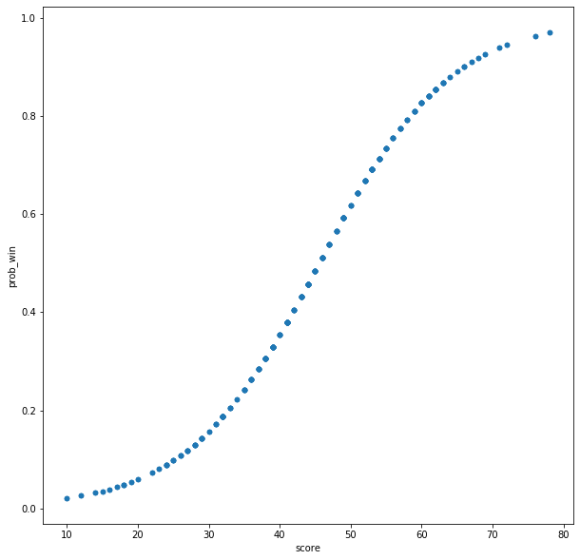
Score vs Probability of Win
Probability of win
Score
Notes:
This figure is a comparison of the probability to win and the match non-standardized scores. You can visually determine what the score will be for a selected probability of win value. For instance, if you are seeking a 60% or better probability of winning you will need a score of 50 or greater.

Slide 17
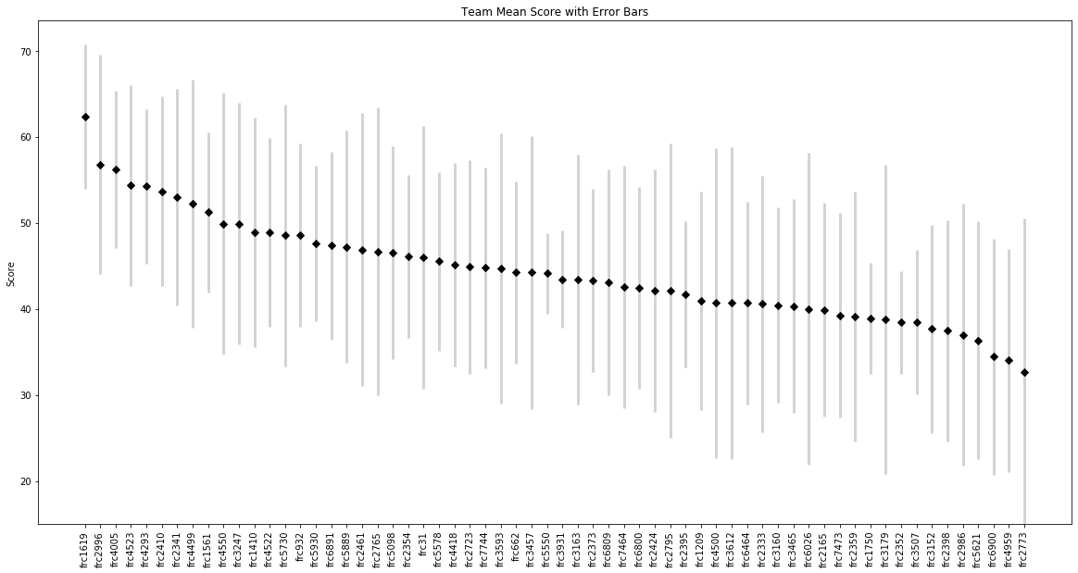
Teams Mean Score w/ Error Bars
Notes:
Here is a plot of the mean score and standard deviation for each team. The mean score is the average score each team achieved in match play. The error bars show the range of scores for each team. In my assumptions I said better teams will aggregate a higher score. Because the scores are actually the result of three teams working together it is important to look at this chart. The error bars are an indicator of how other teams affected that team’s scores. If the error bars are large this indicates that the team was not necessarily the strongest team on the alliance and other team actually had more effect on the overall performance of the alliance.

Slide 18
How the recommendation is created
Two step Process
Step 1
Every team is paired with the subject team (frc2996)
A mean score and probability of win is calculated for the pairing
Step 2
For each pairing the team are compared to the pair
If the teams probability of win is equal or higher than the pairing a new mean score and probability of win is calculated for that alliance
If the teams probability of win is not equal or higher than the pairing that team is skipped
Results
A list of alliances with the alliance mean score and mean probability of win
Notes:
The recommendation is built in two steps. The first step, the subject team is paired with every other team and the mean and probability to win is calculated. The second step is a little more complicated. The pairing is compared to the other team in the event. If the team would increase or at least keep the mean score the same that team is added to the alliance. This is done for all of the teams and a list of selections is generated.

Slide 19
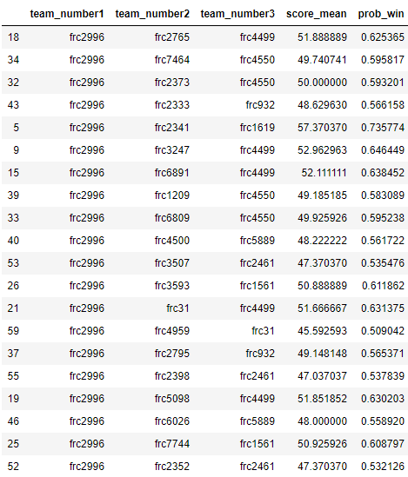
Sample Output
Qualifying scores:
mean: 44.376
min: 32.667
max: 62.333
Notes:
Here is a sample of the generated list. You see the three teams that are a suggested for an alliance, the mean score and probability to win for those teams. Combine this with the scouting information that was collected and final choices can be made.

Slide 20
Factors to consider
The mean score and probability to win is based off of qualification scores
Final round scores increase – see distributions in the data exploration
Other criteria adds to what makes a good alliance partner
Match play scouting is still important
Team History
Notes:
Factors to consider: The mean qualifying scores are used to make the recommendations, score in the final rounds are higher. There are other criteria that makes a good alliance partner: how well did the team play the game, do they have a capability that is better than yours? Was their robot reliable, how accurate was the robot with the game element. Our history with the team.

Slide 21
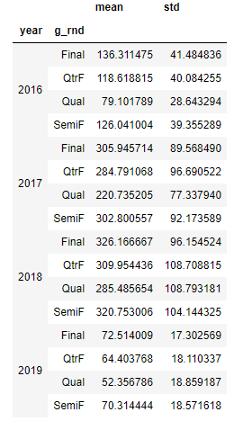
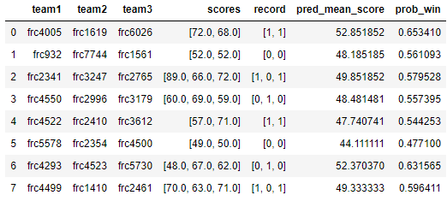
verification
Actual alliances with recommender scores
There is a ~23% lift between Qual and final round scores.
More tuning is needed to better quantify bias from qualification to finals
1/4 Final scores
Notes:
There is not a great way to determine if the recommender is right. So I retrieved the actual alliances from the event. I used the recommender to make the same recommendations. The score column has the score the alliance achieve in the quarter final round and the record column contain whether the alliance won or loosed the matches, a win equals a 1. Team with the higher probability of win faired better than teams with lower probability of win scores. From the mean scores chart, there is a 23% lift in scores from the qualifying round to the quarter final round. If we look at the standard deviation for each round they are all consistent for the first three rounds so if we choose teams with scores that are higher we can have more confidence in the recommendation when it is paired with its probability of winning.

Slide 22
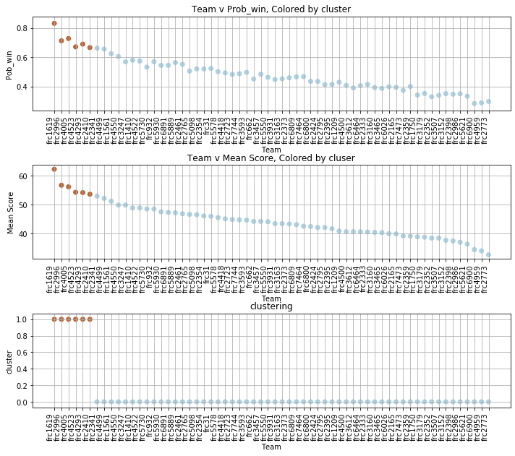
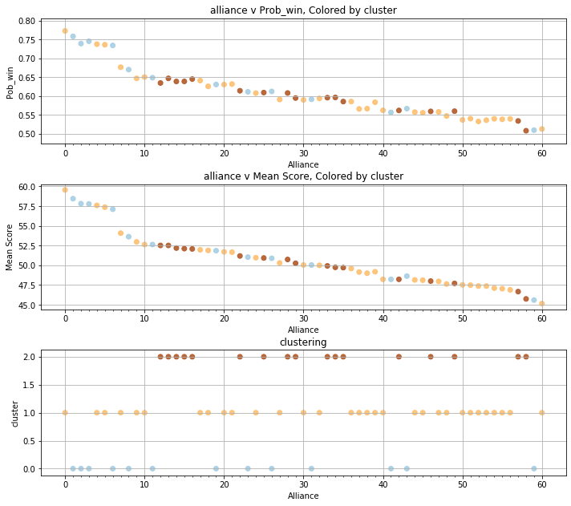
Verification (2)
Notes:
To help verify and give another data point to the decision makers, I use a clustering algorithm to see how the alliance data grouped together. I used a meanShift version of a k-mean clustering. I choose this because I did not need a number of cluster identified before I ran the algorithm, that was determined in processing. The figure on the left is the clustering of the alliances recommended. The color groups identify alliances with similar characteristics. If there was a conflict in getting a team for a recommended alliance pairing because the preferred team has been selected the color group could be use to select a substitute team. I also ran the meanShift against the team scores. The results of this did not really provided any meaningful information. I have just shown this for completeness and disclosures.

Slide 23
What is Next
Operationalize the Notebook code
Create a .py file or class that can be run from the command line or called from another piece of code
Create a series of utilities that summarize data to assist with answering scouting questions
Refine some of the processes to speed them up
Some of the processing took 8 to 12 hours to complete
Refine this work package into a series of lessons that can be taught to the student members of the team
Build processes to read data from a JSON stream for use during competition
Build a team performance predictive model
Use historical score to predict future performance
Plot team scoring tends over time
Build a regional pre-event scouting tool
collect historical team scores,
Metrics: mean scores, standard deviation, trending information
awards won.
Notes:
So there are some things that could still be done. The code in the notebook should be converted to a series of python definition in a class so it could be run from the command prompt or used in another program. There should be some rework of the data cleaning processing to speed it up. That process took hours to complete. A series of lessons should be developed from the workbook to teach the tool and processes to the student members of the team. A JASON file reader should be developed so that the live stream data can be captured at a regional competition. A predictive model could be developed from the data that will predict a teams performance over time. A pre-event scouting tool could be generated to report on the teams scheduled for a future even. This tool could report each teams past performance, awards won, a predicted each team performance.

Slide 24
Lessons Learned
Save data after long processes have been completed
This make recovering data easier if the data structure gets corrupted and a restart is needed
Data preparation is important and time consuming
This effect down line decisions and processes
Be careful of how you name column
Don’t use reserved words as a name
Notes:
Here are some of the significant lessons learned from the project: first after you complete a time intensive process save off the data record. If you have to restart the program you can start with the processed data and not have to start over in the processing of the data. Data preparation is important and having a plan for how the is going to be used. This way you don’t have to recreate an artifact after it has already been deleted. This last one seems like common sense for a programmer, but it was still a problem for me, be aware of command and reserved words, this could cause the program to misinterpret the desired action and cause a execution error.
Thank you for your time.

Slide 25
Thank You

